Slide 1
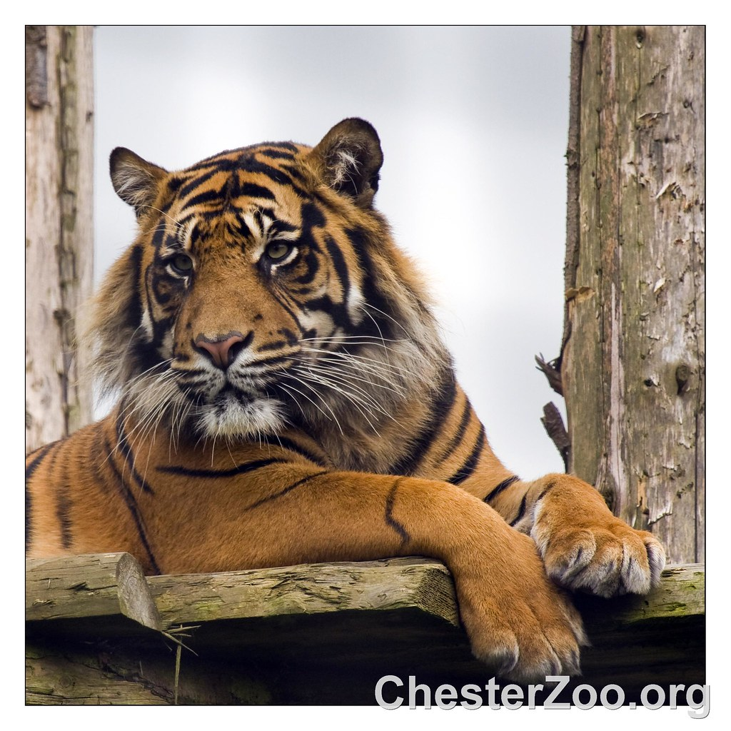
To the Zoo
With Sara Housh
Episode: Pacing Tigers and Animal Enrichment

Slide 2
To the Zoo
With Sara Housh
Episode: Pacing Tigers and Animal Enrichment

Slide 3
To the Zoo
With Sara Housh
Episode: Pacing Tigers and Animal Enrichment

Slide 4
To the Zoo
With Sara Housh
Episode: Pacing Tigers and Animal Enrichment

